Slide 1
Impact of light cone effect on EoR 21-cm Image analysis using LCS
Hemanth Potluri
Roll no : 2203121011
Thesis Supervisor: Dr. Suman Majumdar.
PSPC members: Prof. Abhirup Datta
Dr. Manoneeta Chakraborty.

Slide 2
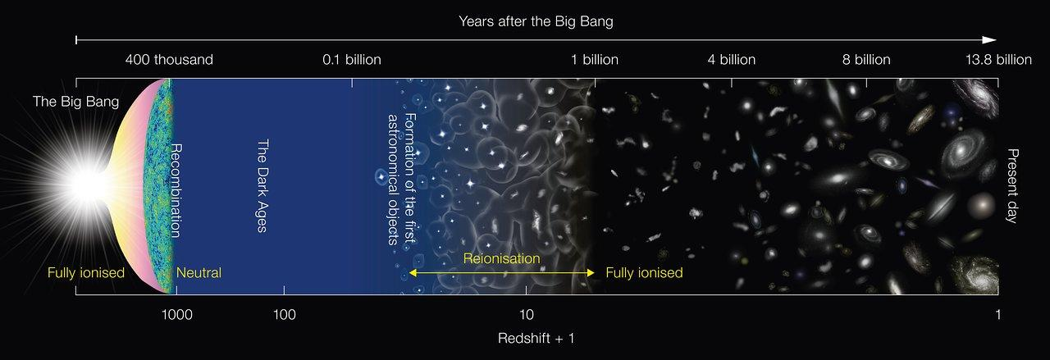
Evolution of the Universe
Credits: NAOJ

Slide 3
Epoch of Reionization
Ionized regions, once formed, start growing in size and overlap with each other as the reionization progresses.

Slide 4
Epoch of Reionization
Ionized regions, once formed, start growing in size and overlap with each other as the reionization progresses.
Epoch of Reionization (EoR) is the period when the neutral matter present in the Intergalactic medium (IGM) had been gradually ionized .

Slide 5
Epoch of Reionization
Ionized regions, once formed, start growing in size and overlap with each other as the reionization progresses.
Epoch of Reionization (EoR) is the period when the neutral matter present in the Intergalactic medium (IGM) had been gradually ionized .
Observationally, the reionization era represents a phase of the Universe which is yet to be probed.

Slide 6
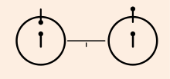
Hyper-fine transition.
When electron in the ground state of neutral Hydrogen (HI) undergo spin-flip transition from parallel to anti-parallel state it emits 21-cm signal.
This 21-cm signal can be used to probe the HI distribution in the universe at different cosmic times and determine the reionization history.
Credits : NASA

Slide 7
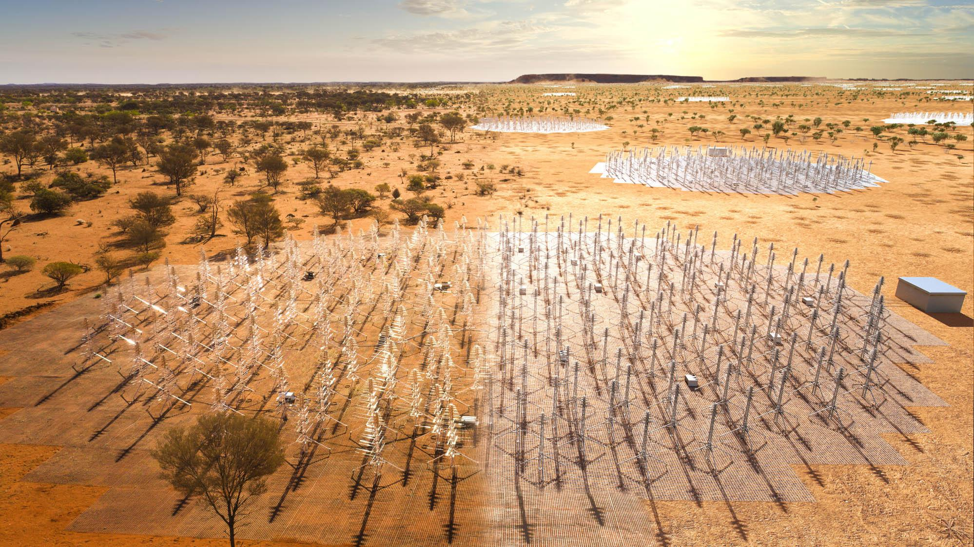
21-cm Observations
First generation telescopes like GMRT, LOFAR, MWA etc. are aiming for statistical detection of 21-cm signal.
The Square Kilometer Array, yet to be commissioned, is expected to have enough sensitivity to make tomographic images of 21-cm signal.
Figure: Artistic image of Square Kilometer Array (SKA)
Image credits: https://www.skao.int/en/explore/telescopes/ska-low

Slide 8
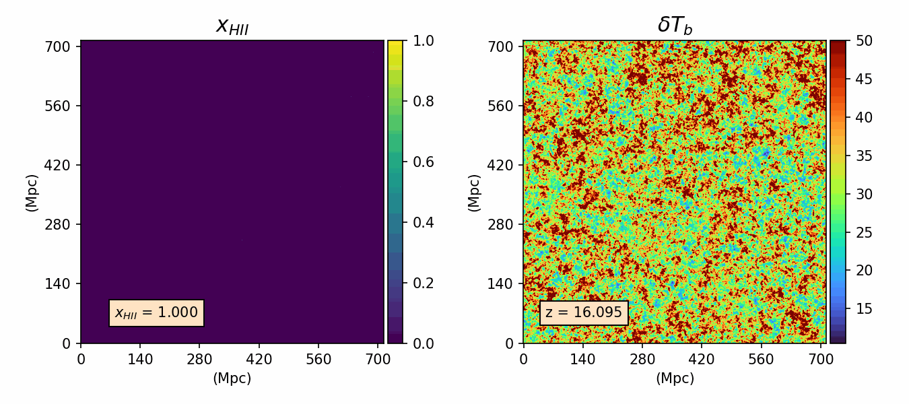
Simulating 21-cm brightness temperature maps
N-body gravity only simulation
x_{HII}
𝛿T_{b}
Friends-of-Friends (FoF) halo finder
Excursion-set based semi-numerical method
21-cm brightness temperature maps

Slide 9
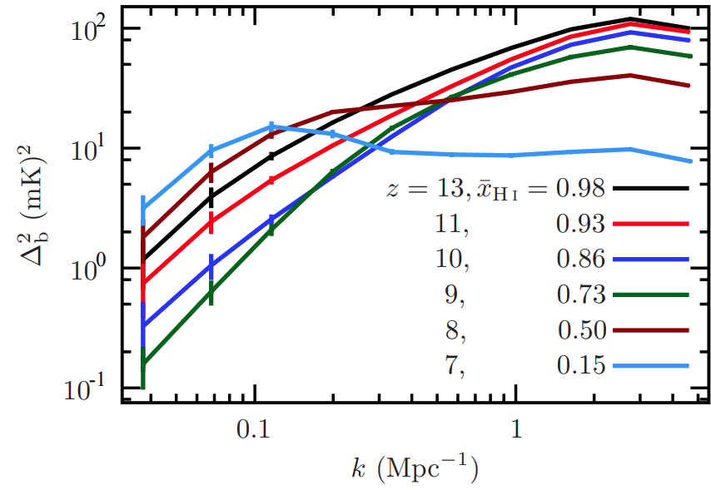
Analyzing 21-cm Signal.
Power spectrum is used to study the distribution of amplitude fluctuations in the signal at various length scales.
Mondal et.al,2015
(arXiv:1508.00896)

Slide 10
Analyzing 21-cm Signal.
Power spectrum is used to study the distribution of amplitude fluctuations in the signal at various length scales.
Phase information of the signal is not retained in power spectrum analysis.
Mondal et.al,2015
(arXiv:1508.00896)

Slide 11
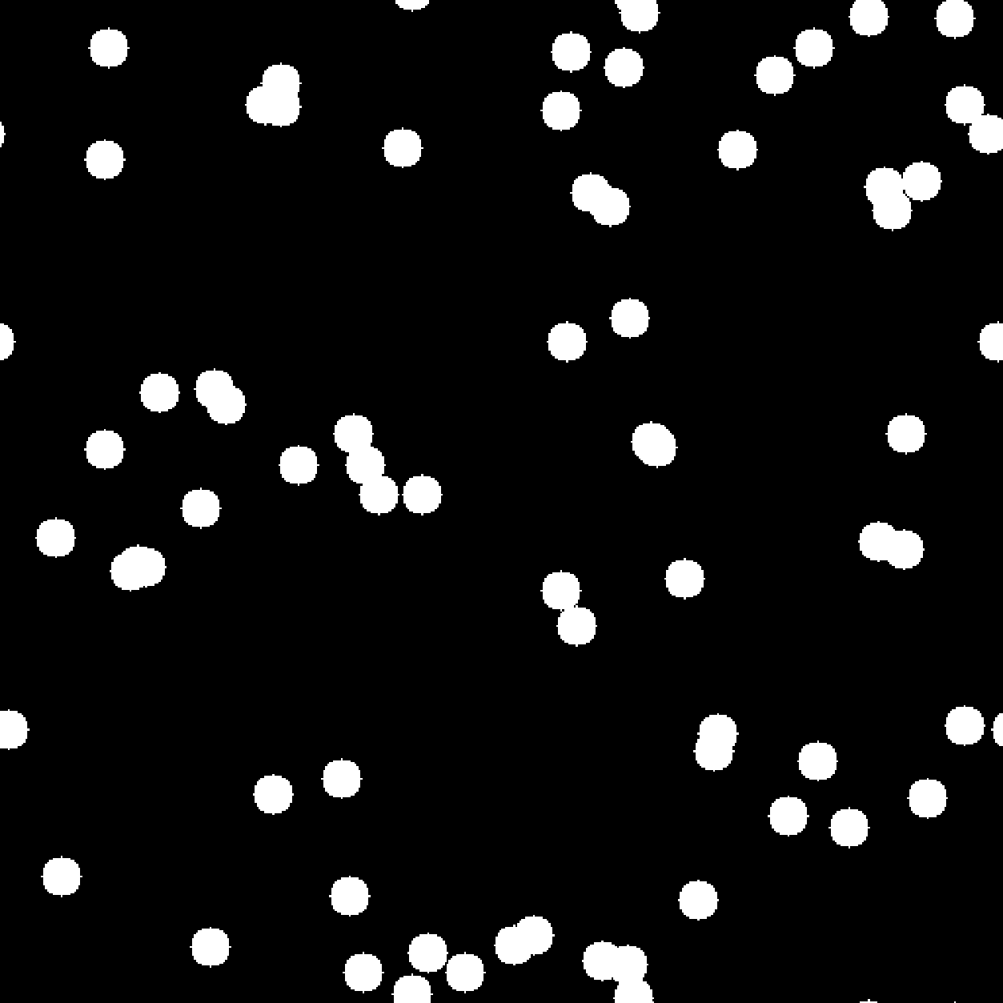
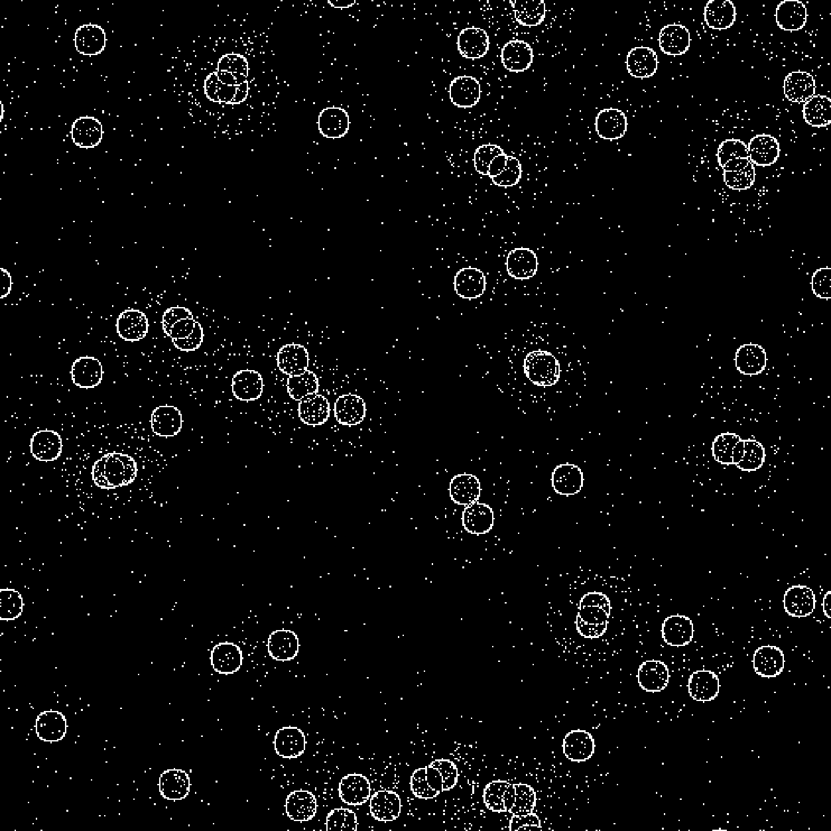
Analyzing 21-cm Signal.
Real field
Phase field
Credits: Gorce and Pritchard, 2019.
(arXiv: 1903.11402)

Slide 12
Percolation analysis
As the reionization progresses, new ionized regions start forming and existing ionized regions increase in their size and overlap with each other.
The formation of the infinitely large singly-connected ionized region is called “Percolation transition”.

Slide 13
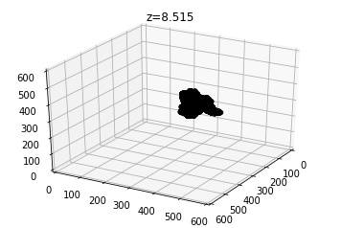
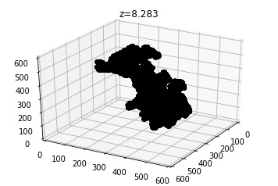
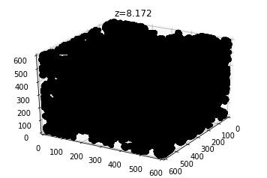
Percolation analysis
As the reionization progresses, new ionized regions start forming and existing ionized regions increase in their size and overlap with each other.
The formation of the infinitely large singly-connected ionized region is called “Percolation transition”.
Credits: Pathak et.al, 2022.
arXiv: 2202.03701

Slide 14
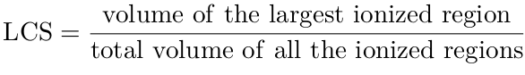
There are two statistics that play key role in percolation analysis.
Largest Cluster Statistics (LCS):
The “Largest Cluster Statistics” is defined for the neutral or the ionized region as the ratio of Volume of the largest neutral (ionized) region to the Total volume of neutral (ionized) regions.

Slide 15
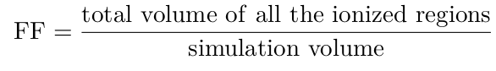
There are two statistics that play key role in percolation analysis.
Largest Cluster Statistics (LCS):
The “Largest Cluster Statistics” is defined for the neutral or the ionized region as the ratio of Volume of the largest neutral (ionized) region to the Total volume of neutral (ionized) regions.
Filling Factor (FF):
The “Filling Factor” for the neutral or the ionized region is defined as the ratio of Total volume of neutral or ionized regions to the Volume of the simulation box.

Slide 16
SURFGEN2
SURFGEN2 algorithm identifies the isolated ionized regions using ‘Friends-of-Friends’ algorithm.
Surface of each ionized region is then mapped using the ‘Marching cube 33’ triangulation algorithm.

Slide 17
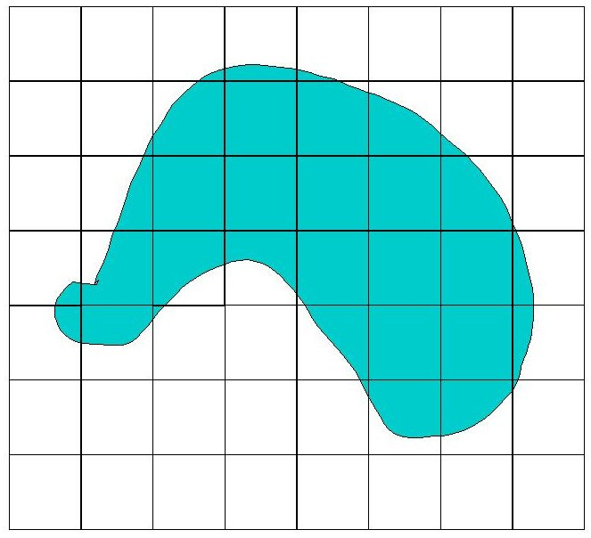
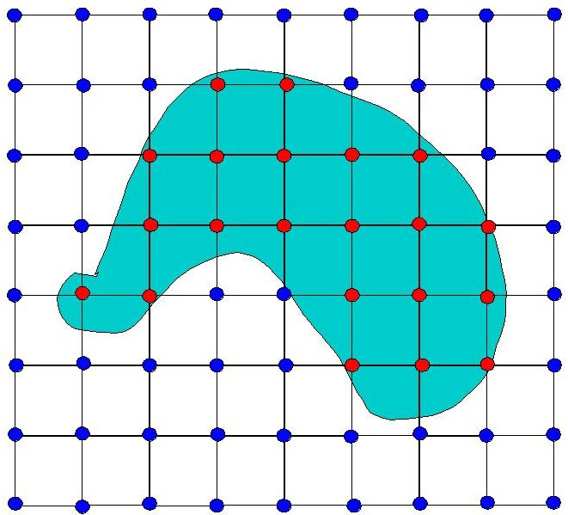
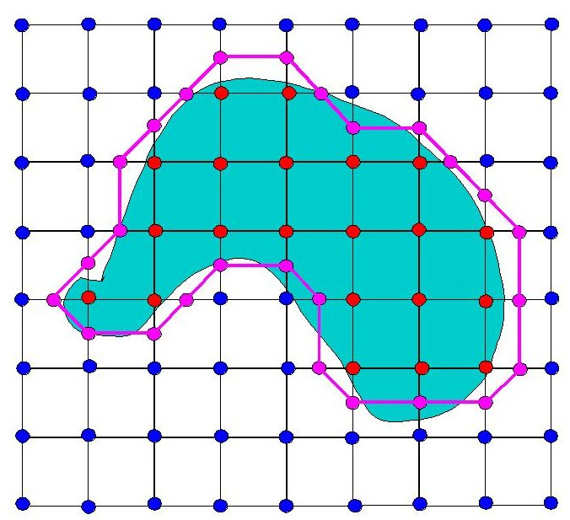
SURFGEN2
SURFGEN2 algorithm identifies the isolated ionized regions using ‘Friends-of-Friends’ algorithm.
Surface of each ionized region is then mapped using the ‘Marching cube 33’ triangulation algorithm.
Credits: Ben Anderson
(https://www.cs.carleton.edu/cs_comps/0405/shape/marching_cubes.html)

Slide 18
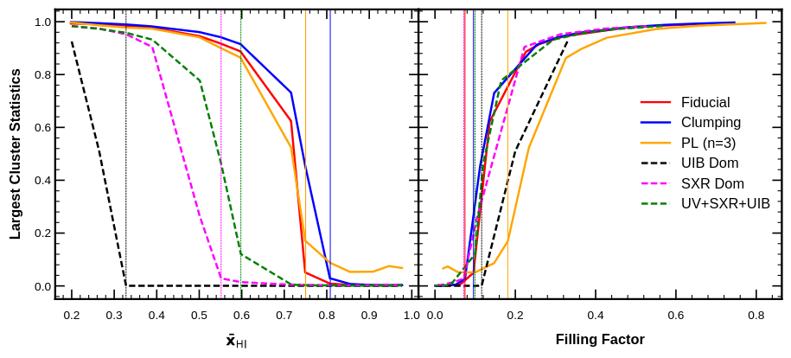
Percolation analysis on simulated coeval maps
Pathak et.al, 2022.
arXiv: 2202.03701

Slide 19
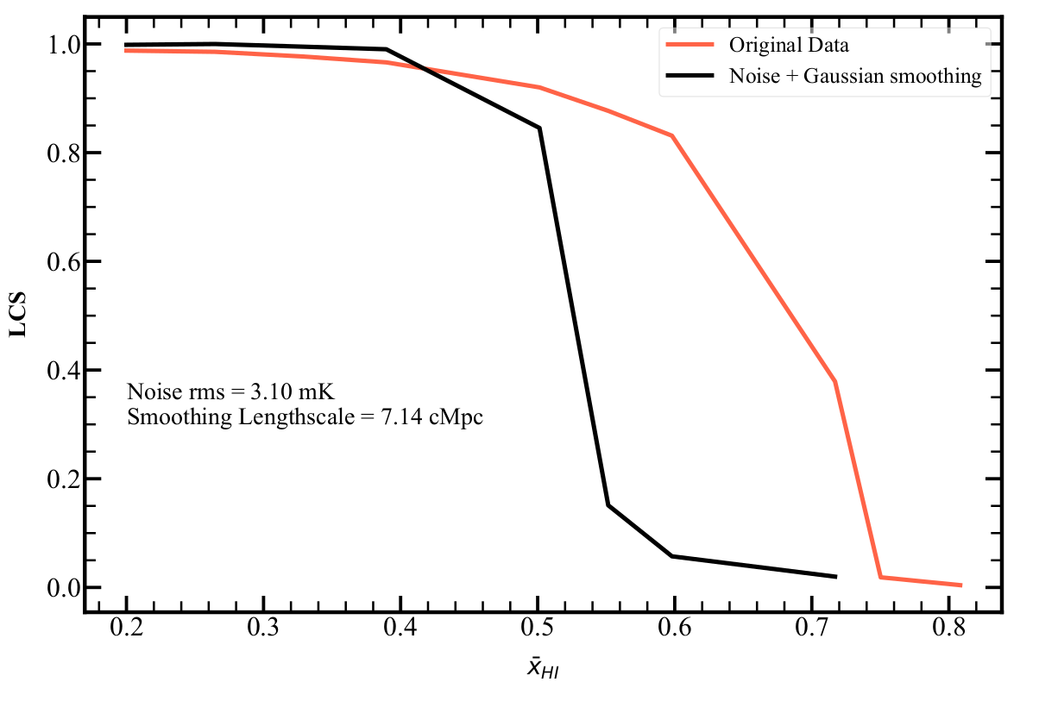
Percolation analysis on simulated coeval maps
Pathak et.al, 2022.
arXiv: 2202.03701
Dasgupta et.al, 2023.
arXiv: 2302.02727

Slide 20
Light-cone effect
By looking deep into the space, we are looking at the universe at its younger state due to finite time it takes for the light to travel to us from distant sources.

Slide 21
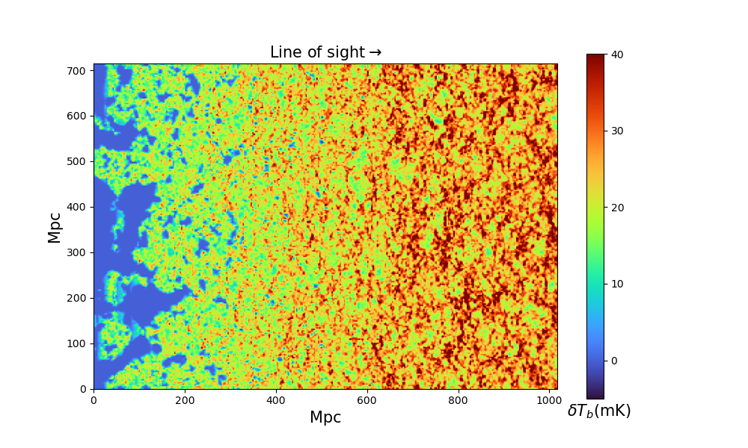
Light-cone effect
By looking deep into the space, we are looking at the universe at its younger state due to finite time it takes for the light to travel to us from distant sources.
The observable 3D volume of the universe is composed of slices from the past.
Figure: A slice cut along the line of sight of a light-cone tomographic map.

Slide 22
Light-cone effect
By looking deep into the space, we are looking at the universe at its younger state due to finite time it takes for the light to travel to us from distant sources.
The observable 3D volume of the universe is composed of slices from the past.
Coeval maps are used to generate simulated light cone maps.
Figure: A slice cut along the line of sight of a light-cone tomographic map.

Slide 23
The light cone simulated cubes are generated from coeval cubes as follows:
A set of 16 brightness temperature maps at different redshifts each of integer size 600³ and physical comoving size (714 Mpc)³ are considered.
Starting from the lowest redshift, we create a redshift series , which will constitute the redshift (Line of sight) axis of the light cone cube.
We then construct the light cone cube by stepping through this redshift series and constructing 21-cm slices for each redshift.
We use linear interpolation technique to create 21-cm slice at intermediate redshifts of the given redshift series.
z₁
z₂
z₃
. . . . . . . . . . .
z₁₆
LOS

Slide 24
The light cone map is cut into overlapping sub-volumes of uniform sizes (in co-moving distance) of different magnitude and LCS is computed for these chunks of uniform sizes.
The change in LCS for sub-volumes of different sizes is then quantified and compared with that of LCS of coeval cubes at different redshifts.
Overlapping region
Non-overlapping
Overlapping

Slide 25

Percolation analysis on light-cone maps
Fiducial model
100% UV photon contribution from galaxies residing in halos.
Density independent uniform rate of recombination.
Figure: A slice cut along the line of sight of a light-cone tomographic map of fiducial model.

Slide 26
Percolation analysis on light-cone maps
Fiducial model
100% UV photon contribution from galaxies residing in halos.
Density independent uniform rate of recombination.
N_{𝛄} (M_{h}) ∝ M_{h}
Where N_{𝛄} (M_{h}) = Total number of
ionizing photons
emitted from a halo
of mass “M”
M_{h} = Mass of halo.
Figure: A slice cut along the line of sight of a light-cone tomographic map of fiducial model.

Slide 27
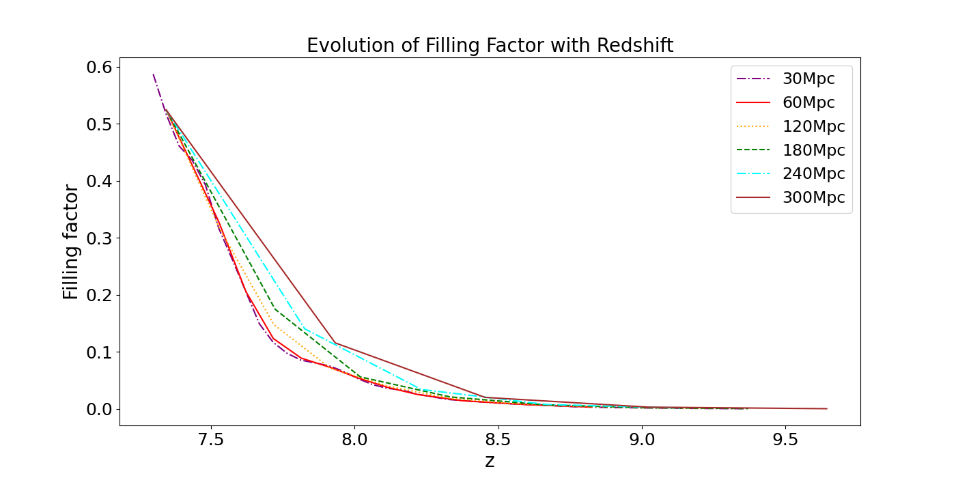
Percolation analysis on light-cone maps
Fiducial model

Slide 28
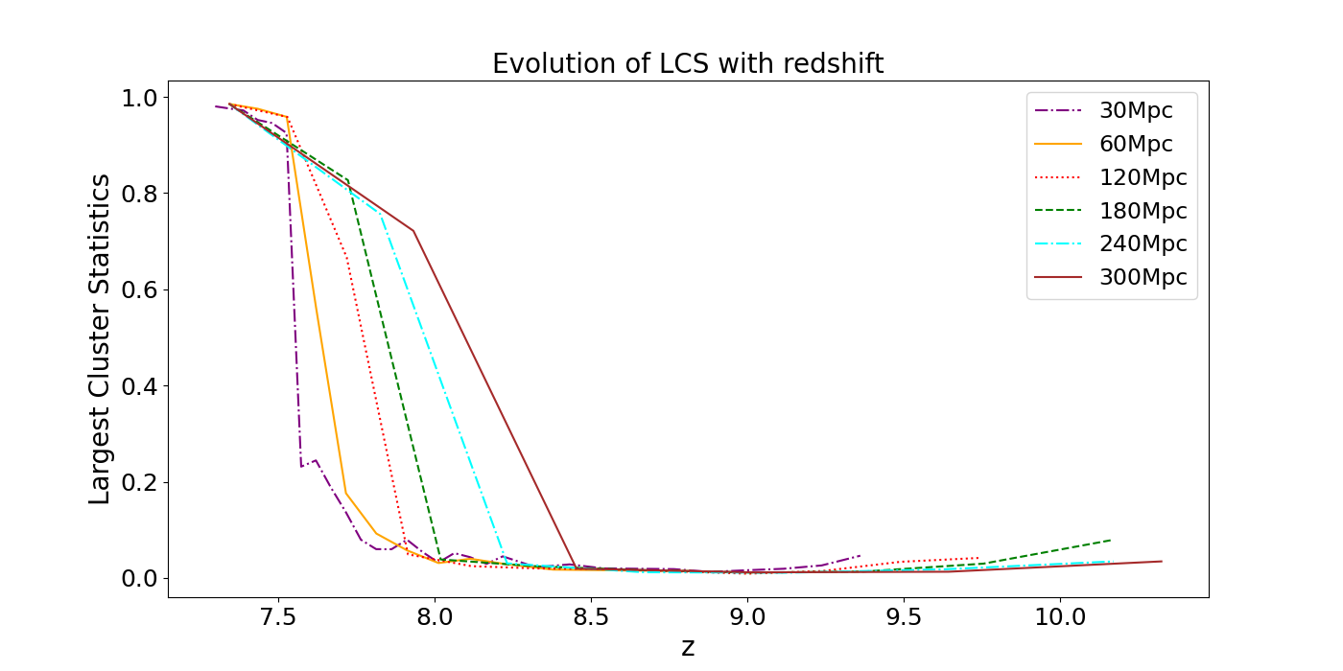
Percolation analysis on light-cone maps
Fiducial model

Slide 29
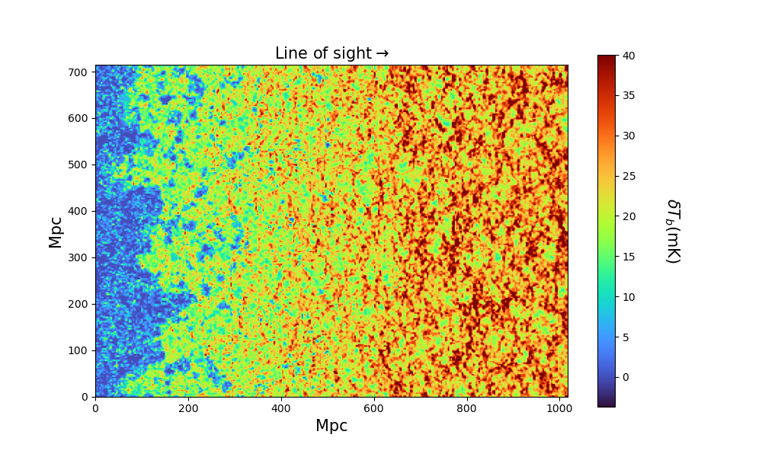
Percolation analysis on light-cone maps
Clumping model
100% UV photon contribution from galaxies residing in halos.
Non-uniform density dependent recombination.
N_{𝛄} (M_{h}) ∝ M_{h}
Where N_{𝛄} (M_{h}) = Total number of
ionizing photons
emitted from a
halo of mass “M”
M_{h} = Mass of halo.
Figure: A slice cut along the line of sight of a light-cone tomographic map of clumping model.

Slide 30
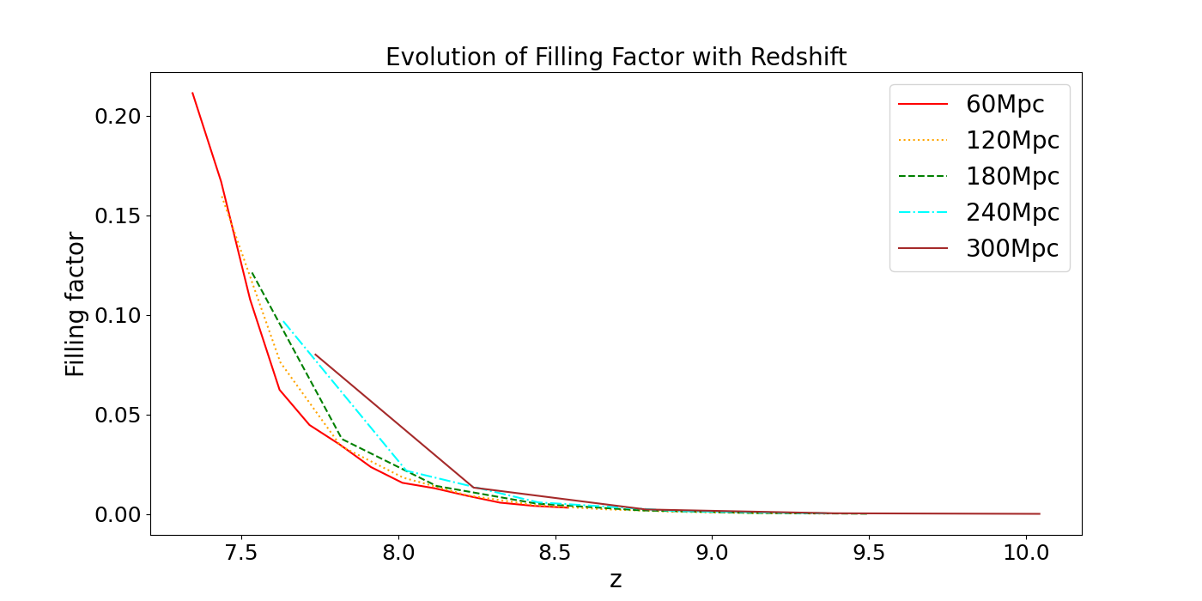
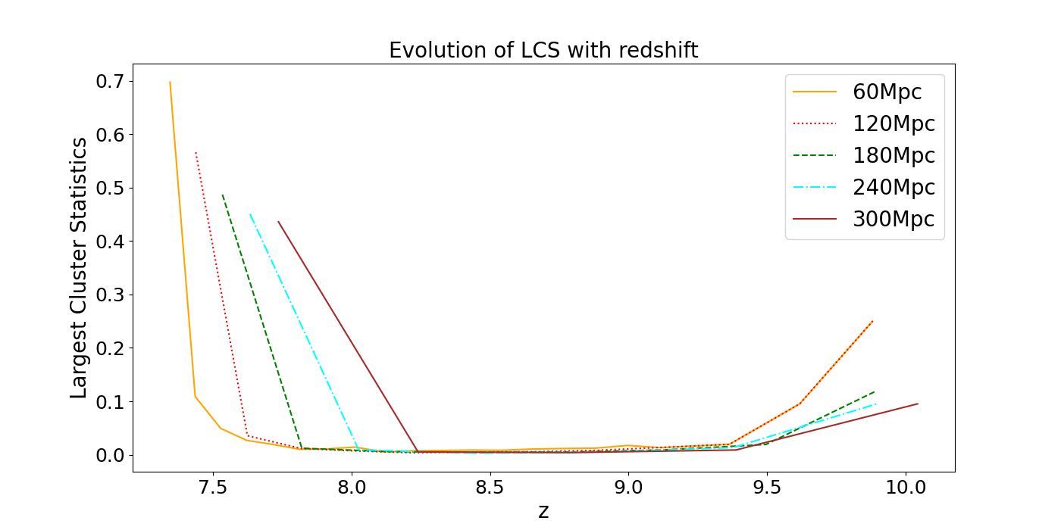
Percolation analysis on light-cone maps
Clumping model

Slide 31
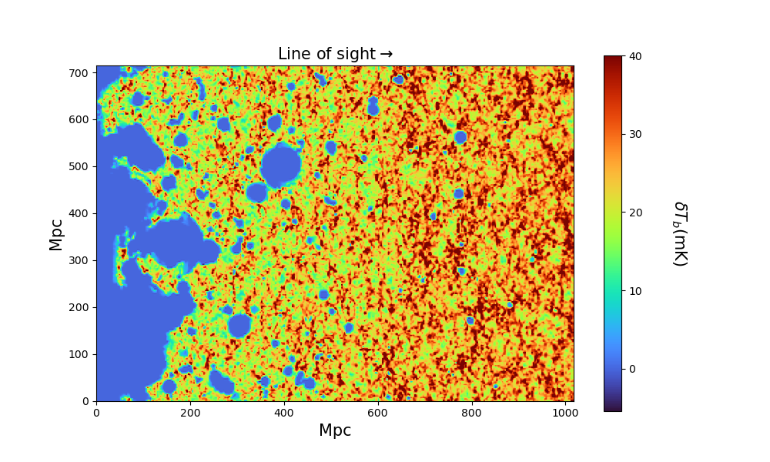
Percolation analysis on light-cone maps
Power law (n=3)
100% UV photon contribution from galaxies residing in halos.
Density independent uniform rate of recombination.
Figure: A slice cut along the line of sight of a light-cone tomographic map of PL (n=3) model.

Slide 32
Percolation analysis on light-cone maps
Power law (n=3)
100% UV photon contribution from galaxies residing in halos.
Density independent uniform rate of recombination.
N_{𝛄} (M_{h}) ∝ M_{h}³
Where N_{𝛄} (M_{h}) = Total number of
ionizing photons
emitted from a
halo of mass “M”
M_{h} = Mass of halo.
Figure: A slice cut along the line of sight of a light-cone tomographic map of PL (n=3) model.

Slide 33
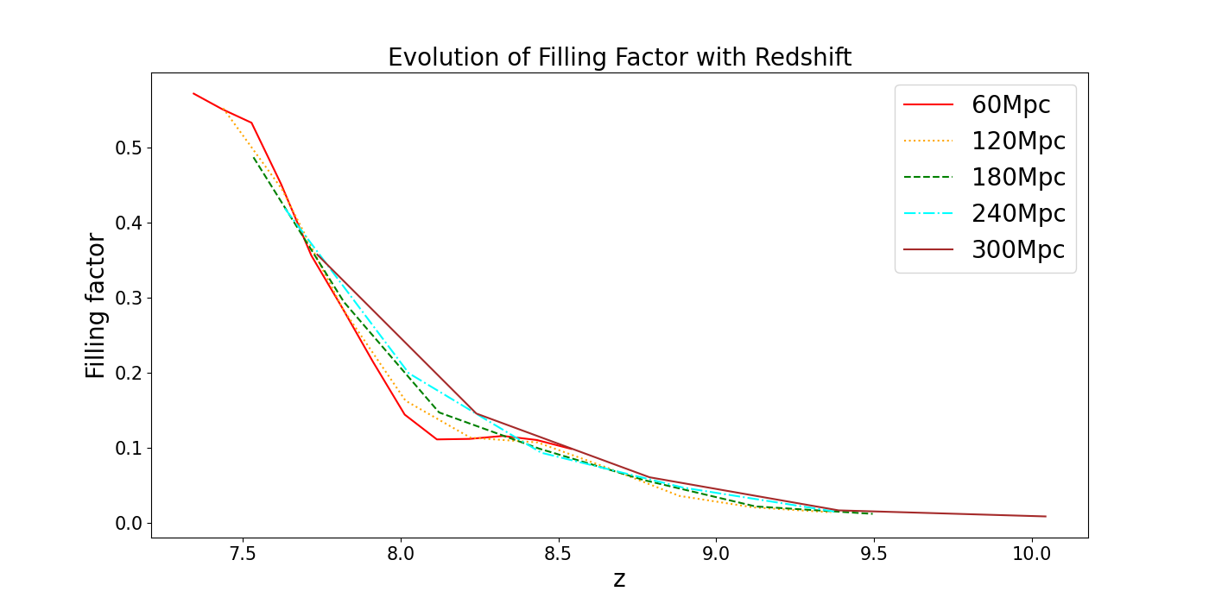
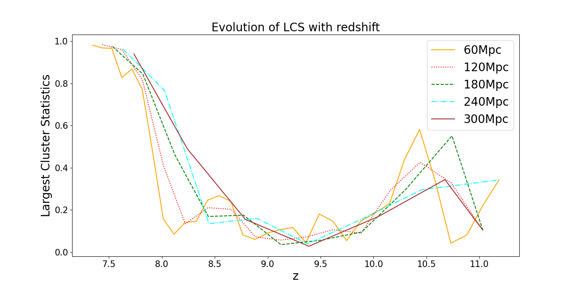
Percolation analysis on light-cone maps
Power law (n=3)

Slide 34
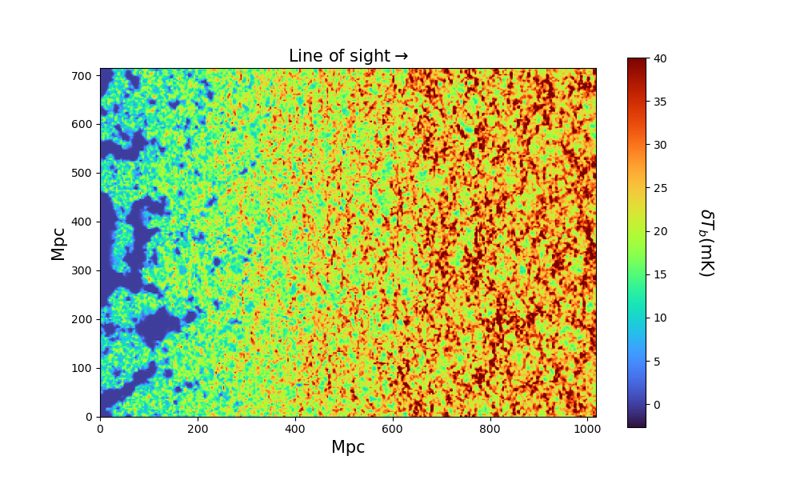
Percolation analysis on light-cone maps
UV+SXR+UIB
50% UV photon contribution + 10% hard X-ray photon contribution + 40% soft X-ray contribution.
Density independent uniform rate of recombination.
Figure: A slice cut along the line of sight of a light-cone tomographic map of UV+SXR+UIB model.

Slide 35
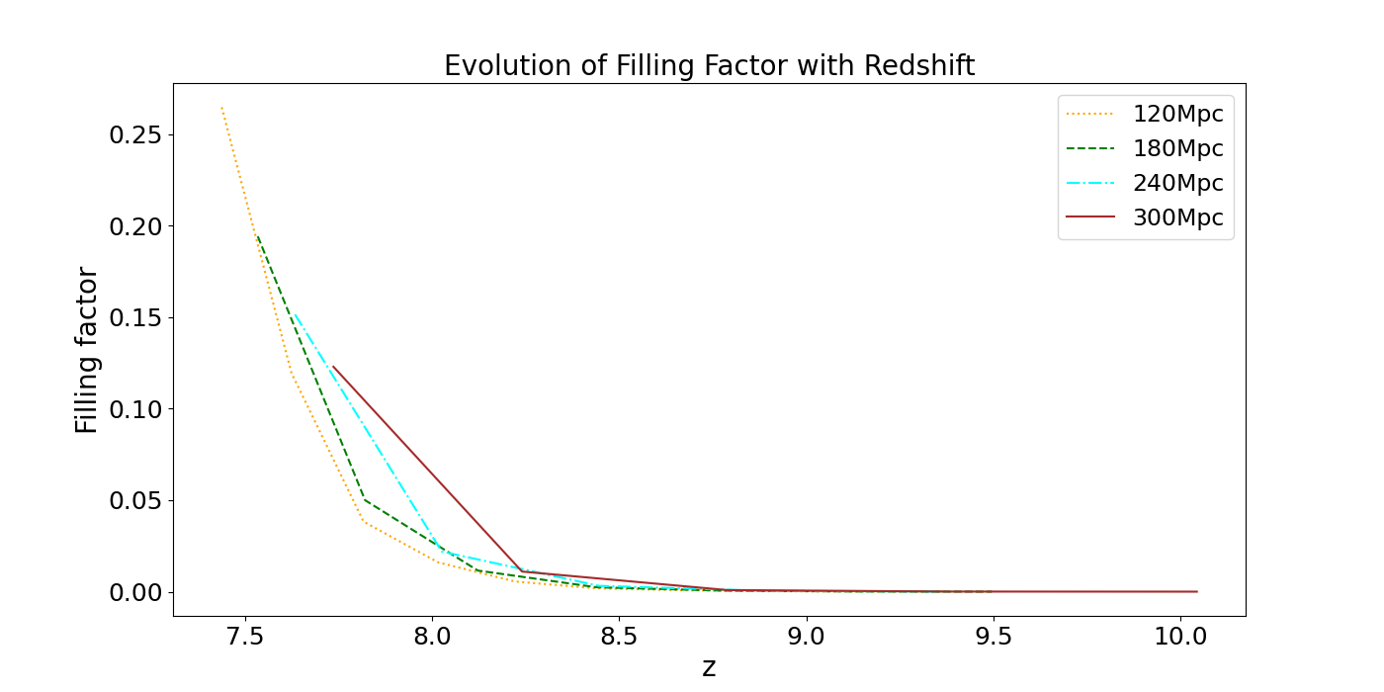
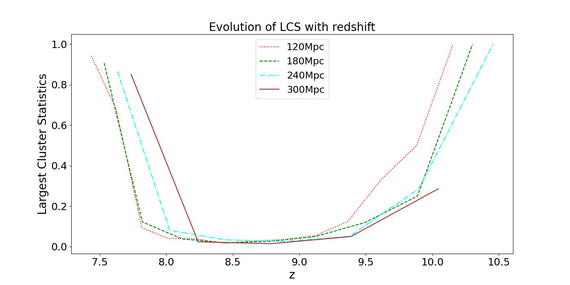
Percolation analysis on light-cone maps
UV+SXR+UIB

Slide 36
Summary
Volume of chunk chosen impacts the evolution of LCS with redshift for all the reionization scenarios.

Slide 37
Summary
Volume of chunk chosen impacts the evolution of LCS with redshift for all the reionization scenarios.
Except power law (n=3) model, all the reionization scenarios retains the trend of the evolution of LCS.

Slide 38
Summary
Volume of chunk chosen impacts the evolution of LCS with redshift for all the reionization scenarios.
Except power law (n=3) model, all the reionization scenarios retains the trend of the evolution of LCS.
Different reionization scenarios can be distinguished from each other by doing LCS analysis even after light-cone effect is taken into account.

Slide 39
Future work
What happens to LCS when we include the telescope beam, noise, foregrounds etc. on light cone maps?

Slide 40
Future work
What happens to LCS when we include the telescope beam, noise, foregrounds etc. on light cone maps?
Is it possible to constrain EoR history using LCS taking light-cone effect into account?

Slide 41
Future work
What happens to LCS when we include the telescope beam, noise, foregrounds etc. on light cone maps?
Is it possible to constrain EoR history using LCS taking light-cone effect into account?
How does the morphology of ionized regions evolve for different reionization models when light-cone effect is taken into account?

Slide 42
Simulating 21-cm ionization maps
Dark matter distribution is obtained from N-body gravity only
simulation.
Friends-of-Friends (FoF) algorithm is used to identify dark matter halos
The identified halos are populated with ionizing sources and number of ionizing photons emitted by these sources are ascertained.
The ionization of neutral hydrogen is modelled by transport of ionizing photons.

Slide 43
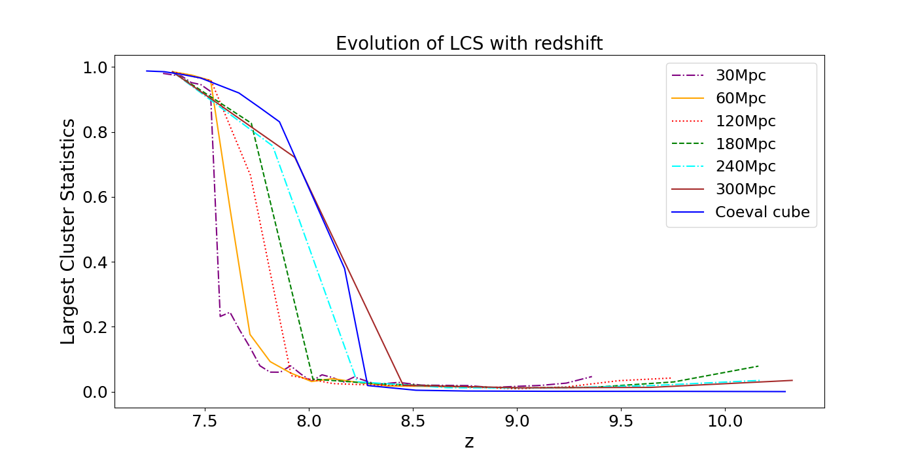

Slide 44
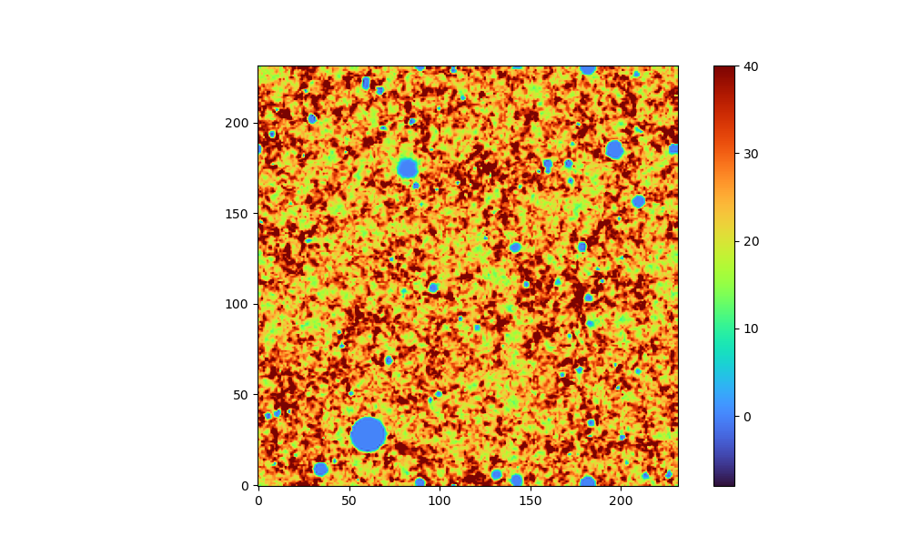
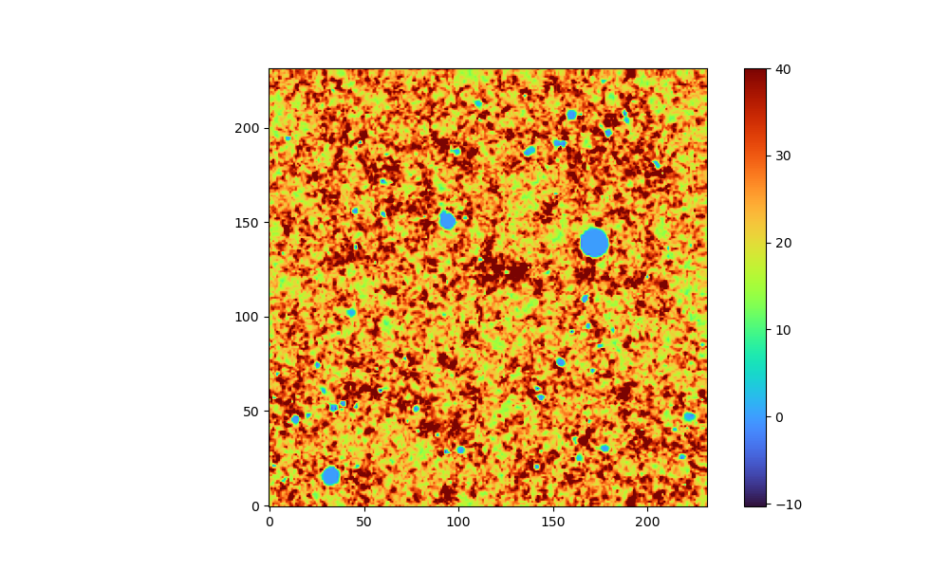
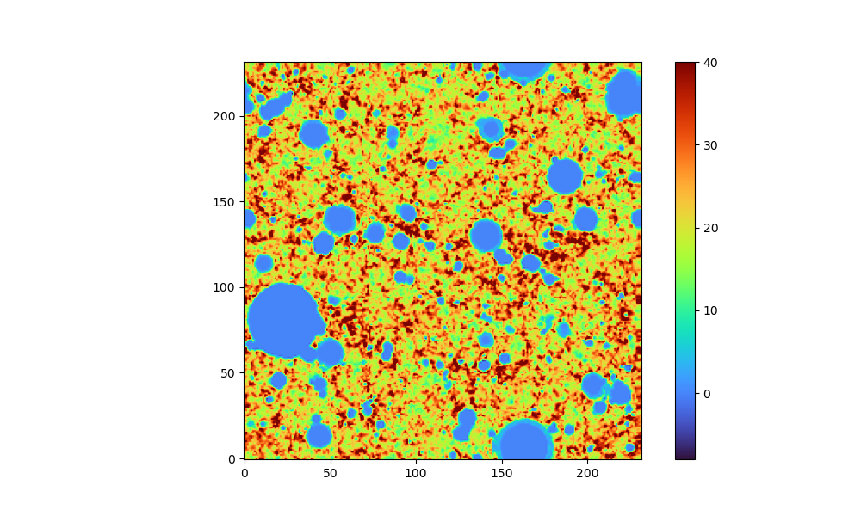
z=10.3
z=10.0
z=9.92

